Slide 1

Enterprise Software Development
Notes:
TODO: add on slide title 1.2

Slide 2

Write sexier code with RxJS
Dev Super Powers
Notes:
I wish I had been given this talk

Slide 3

Duncan Hunter
@DuncHunter
Software Architect
Focus on Angular and TypeScript
Rock climber
Notes:
Spend the most of my time building ng and ts
This is actually me in Jervis Bay south of Sydney
Follow me on twitter

Slide 4

Agenda
1. What are observables
2. Operators
3. How to use Observables with Angular 2 http module
4. Advanced example with typeahead and websockets
5. More information
Notes:
Approx. 45min for the 10 qu and the Q&A

Slide 5
Slides are online here
http://bit.ly/angular2observables

Slide 6
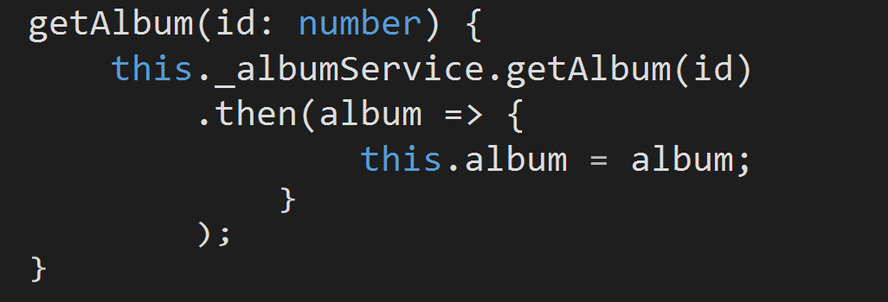
Who is familiar with Promises in angular?
Notes:
Who is a gun?
Who is new to observables and Angular 2 will be their first rxjs
This is an intro to it

Slide 7
Who is using RxJS?
Notes:
Who is a gun?
Who is new to observables and Angular 2 will be their first rxjs
This is an intro to it

Slide 8
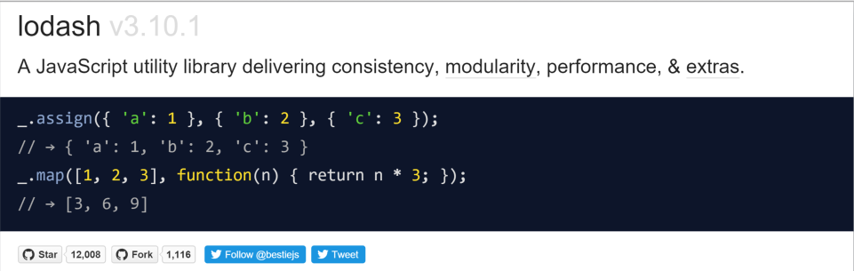
Who is using lodash?
Notes:
Who is a gun?
Who is new to observables and Angular 2 will be their first rxjs
This is an intro to it

Slide 9

1. What are Observables?
Notes:
Angular 1 there's no way to load them asynchronously, without hacky solutions.
Well, Angular2 uses the ES6 modules.
This allows creating bundles with the modules, which are required during the initial page load and loading all others on demand, asynchronously.
Which is awesome
Opens up room for using tools like JSPM and WebPack to manage our build process in more sophisticated and simpler ways.

Slide 10
Observables are like a promise except they can take many values over time.

Slide 11
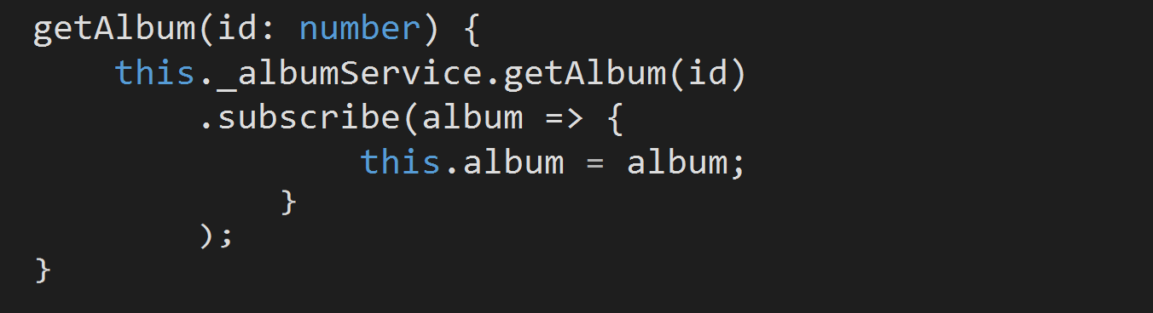
Just like .then() You can call .subscribe()

Slide 12
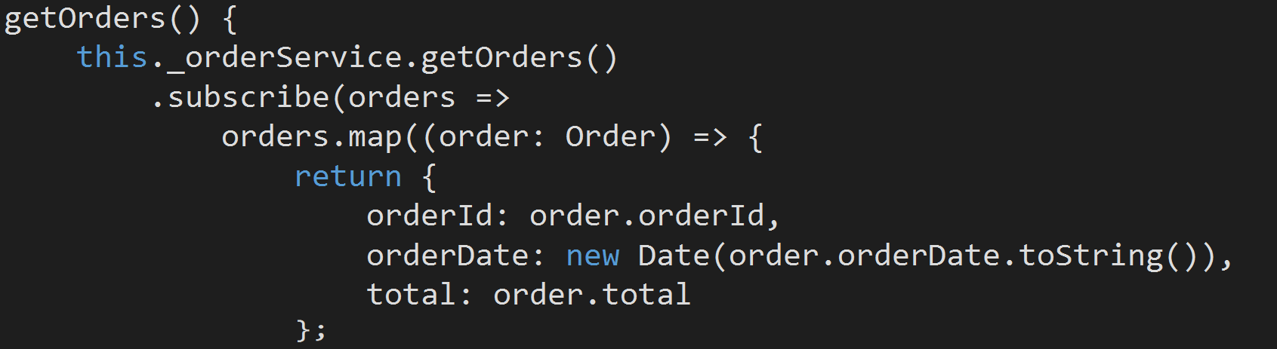
You can call perform operations on the values returned from .subscribe()

Slide 13

Angular 2 will have observables using Rx.JS
Notes:
Angular 1 there's no way to load them asynchronously, without hacky solutions.
Well, Angular2 uses the ES6 modules.
This allows creating bundles with the modules, which are required during the initial page load and loading all others on demand, asynchronously.
Which is awesome
Opens up room for using tools like JSPM and WebPack to manage our build process in more sophisticated and simpler ways.

Slide 14
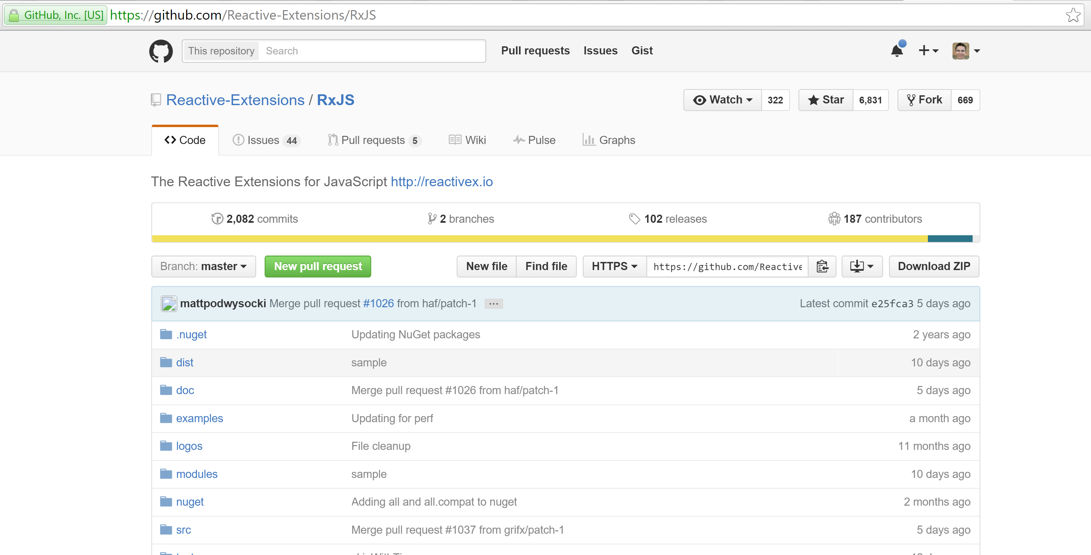
Reactive-Extensions Version 4
Notes:
Not an issue as ships with angular

Slide 15
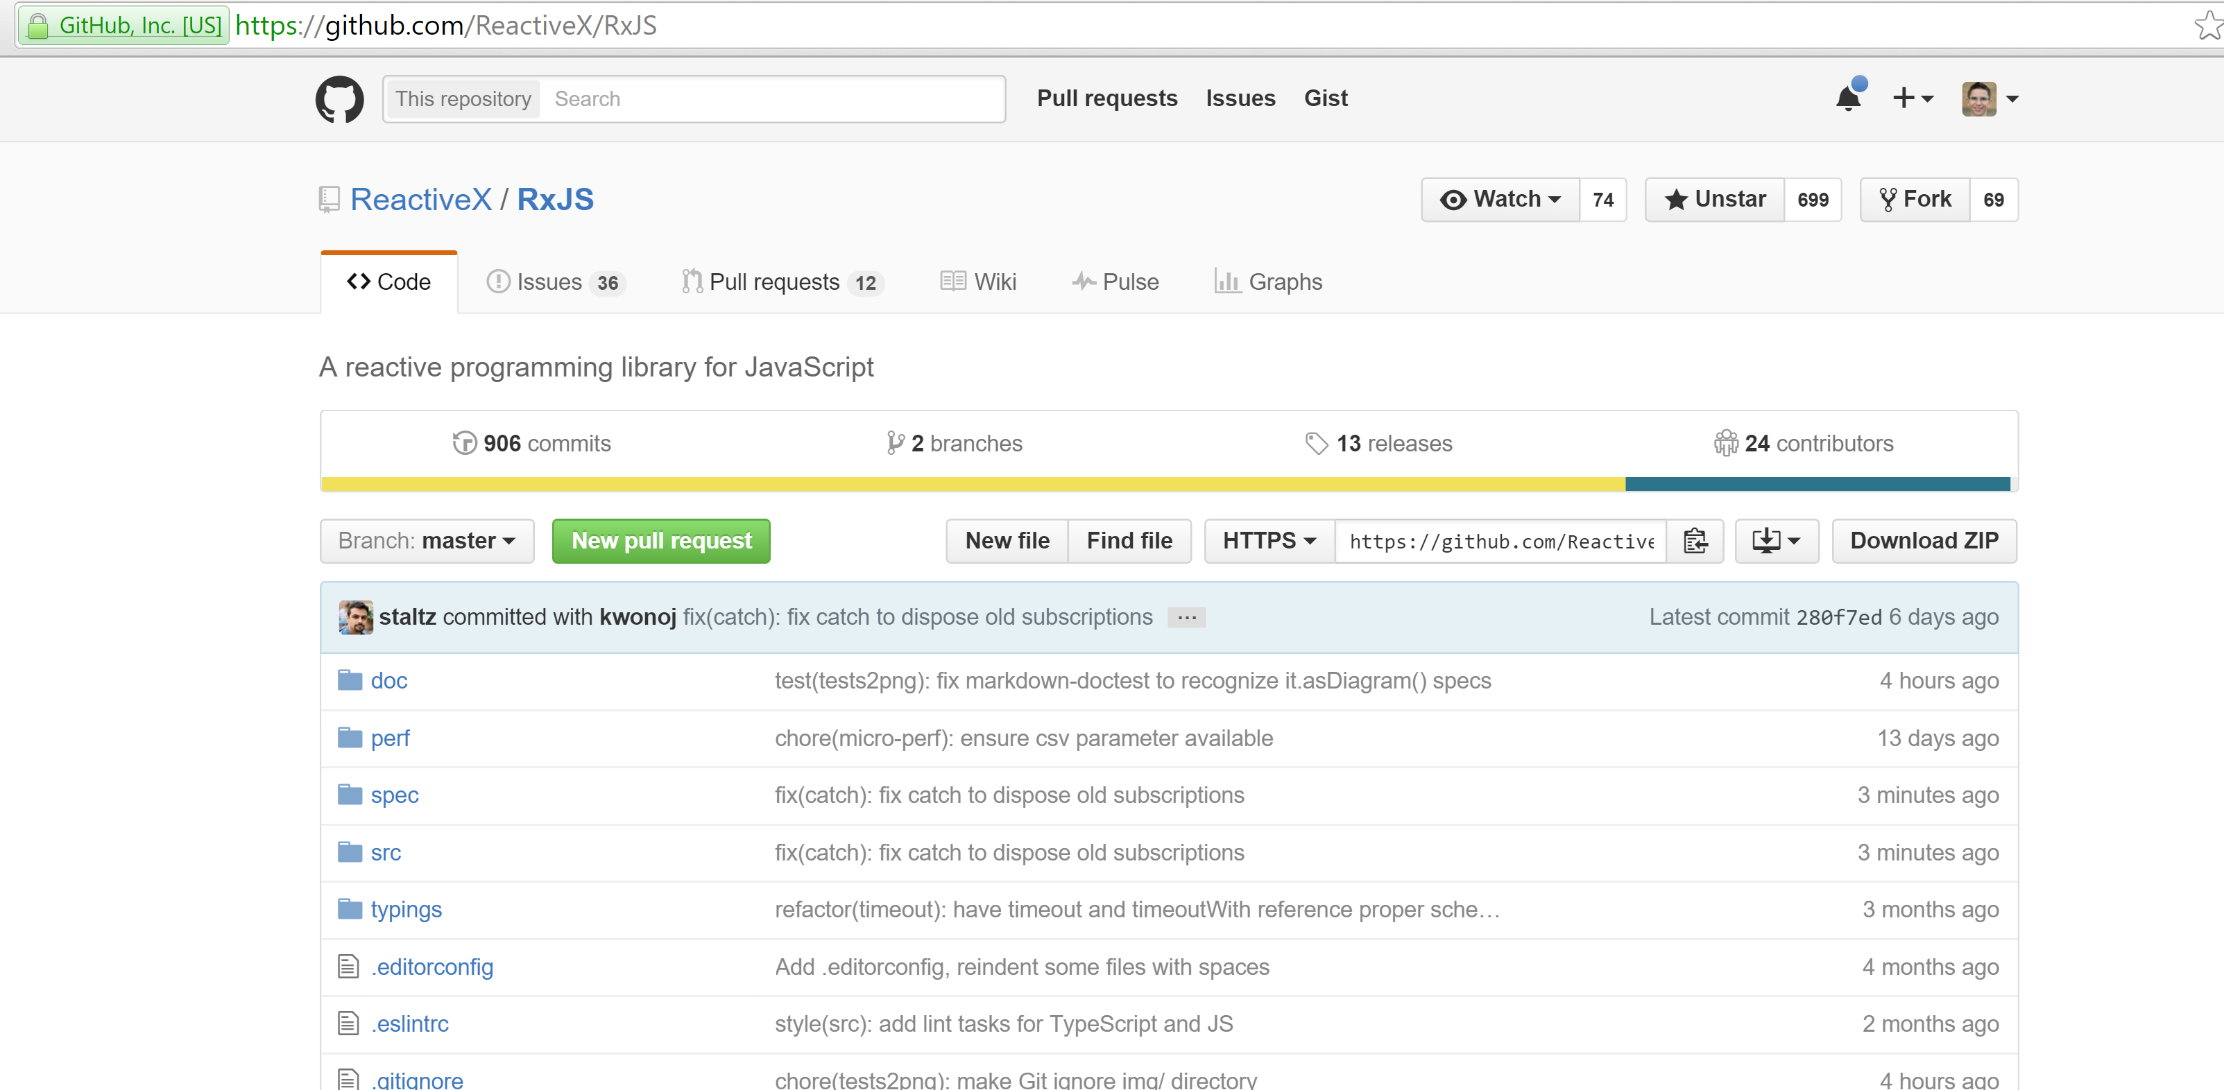
ReactiveX
version 5 (alpha)

Slide 16
RxJS it is a different way of thinking about things and it will take time to adapt

Slide 17
In Angular 1 we used lots of promises
In Angular 2 we will use lots of observables

Slide 18
"The Reactive Extensions for JavaScript (RxJS) is a set of libraries for composing asynchronous and event-based programs using observable sequences and fluent query operators that many of you already know by Array#extras in JavaScript. Using RxJS, developers represent asynchronous data streams with Observables, query asynchronous data streams using our many operators, and parameterize the concurrency in the asynchronous data streams using Schedulers. Simply put, RxJS = Observables + Operators + Schedulers."

Slide 19
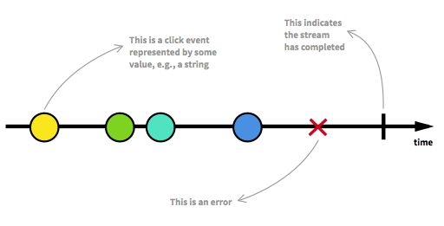
RxJS you work with streams of data
Notes:
This is my goal for this presentation which Adam thinks is a very ambitious goal
I hear product owners we build software for say

Slide 20
RxJS operators are like lodash

Slide 21
“Observables are like lodash for async”
Notes:
This is my goal for this presentation which Adam thinks is a very ambitious goal
I hear product owners we build software for say

Slide 22

Without lodash I felt like….

Slide 23

With lodash I felt like….

Slide 24

With RxJS I feel like….

Slide 25

And sometimes with RxJS I feel like this…

Slide 26
Why not promises
Angular2 Http module doesn't just return promises
We can do much more with observables
We avoid call back hell

Slide 27
Why observables not promises
Observables are lazy
Observables can be cancelled
Observables declare all logic at start up
Observables can happen over time

Slide 28
.subscribe()
http.get(‘api/albums’).then…
x().then(valueFn, errorFn);
x().subscribe(valueFn, errorFn, completionFn);
let sub = x().subscribe(valueFn, errorFn, completionFn);
sub.unsubscribe()

Slide 29
Error handling - Kind of similar to promises:
finally()
catch()
retry(3) – not in promises

Slide 30
2. Operators
Notes:
Angular 1 there's no way to load them asynchronously, without hacky solutions.
Well, Angular2 uses the ES6 modules.
This allows creating bundles with the modules, which are required during the initial page load and loading all others on demand, asynchronously.
Which is awesome
Opens up room for using tools like JSPM and WebPack to manage our build process in more sophisticated and simpler ways.

Slide 31
Operators will be your new
“if” and “for loops”!

Slide 32
The five main operators according to Jafar Husain
map()
filter()
concatAll()
reduce()
zip()
Notes:
This is what jafar Hussain from netflix says

Slide 33
But it can be very confusing knowing which operator to use?

Slide 34
Example of observables and operators
Observable: https://jsbin.com/fibewa/5/edit?js,console
Non observable https://jsbin.com/gotose/1/edit?js,console
Double click http://jsfiddle.net/staltz/4gGgs/27/

Slide 35
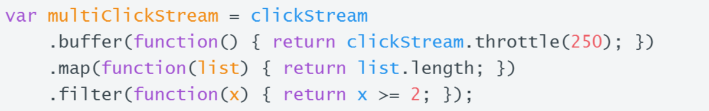
Double click stream

Slide 36
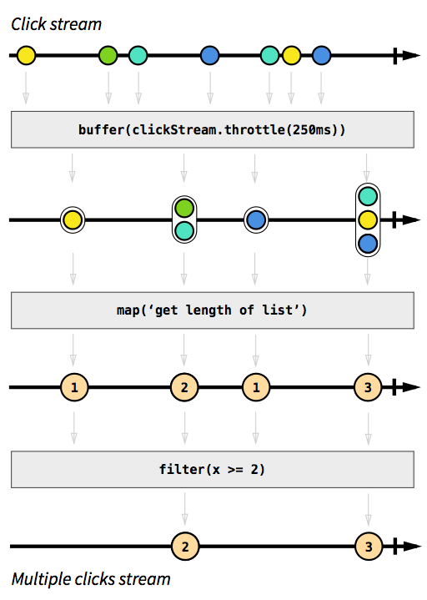

Slide 37
Simple operators
map()
filter()
reduce()
first()
last()
single()
elementAt()
toArray()
isEmpty()
take()
skip()
startWith()
and many more.....

Slide 38
Merging and joinging operators
merge()
mergeMap()
concat()
concatMap()
switch()
switchMap()
combineLatest()
withLatestFrom()
zipp()
forkJoin()
expand()

Slide 39
Buffering operators
buffer()
throttle()
debounce()
sample()

Slide 40
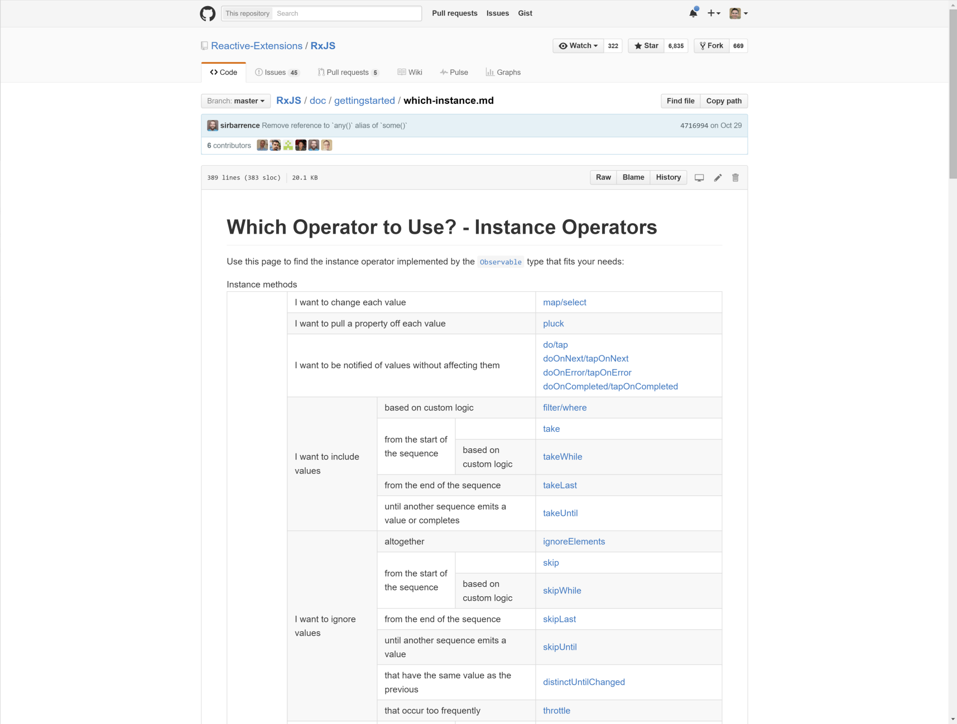

Slide 41
3 and 4 Angular2 Http module Typeahead example
Notes:
Angular 1 there's no way to load them asynchronously, without hacky solutions.
Well, Angular2 uses the ES6 modules.
This allows creating bundles with the modules, which are required during the initial page load and loading all others on demand, asynchronously.
Which is awesome
Opens up room for using tools like JSPM and WebPack to manage our build process in more sophisticated and simpler ways.

Slide 42
Code walk through
Angular2 http module
Typeahead
Stockticker

Slide 43


Slide 44
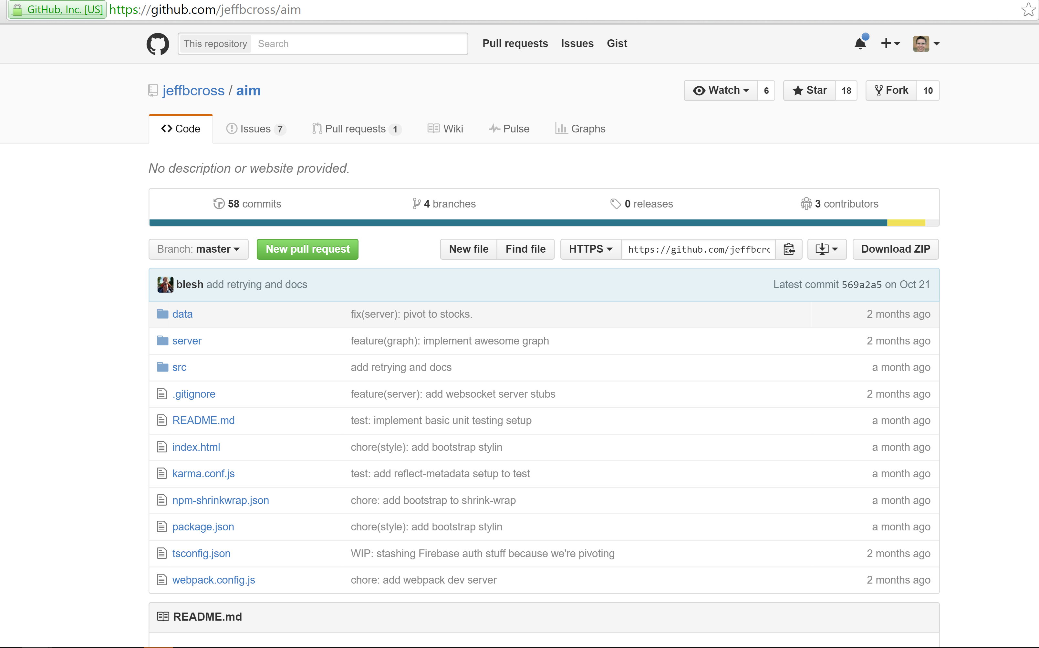

Slide 45
5 Resources
Notes:
Angular 1 there's no way to load them asynchronously, without hacky solutions.
Well, Angular2 uses the ES6 modules.
This allows creating bundles with the modules, which are required during the initial page load and loading all others on demand, asynchronously.
Which is awesome
Opens up room for using tools like JSPM and WebPack to manage our build process in more sophisticated and simpler ways.

Slide 46
Resources
egghead.io https://egghead.io/technologies/rx
RxJS In-Depth – Ben Lesh https://www.youtube.com/watch?v=KOOT7BArVHQ
Angular 2 Data Flow – Jeff Cross, Rob Wormald and Alex Rickabaugh https://www.youtube.com/watch?v=bVI5gGTEQ_U
The introduction to Reactive Programming you've been missing https://gist.github.com/staltz/868e7e9bc2a7b8c1f754
Angular 2 music store by SSW https://github.com/SSWConsulting/musicstore-ui-angular2-dotnet

Slide 47
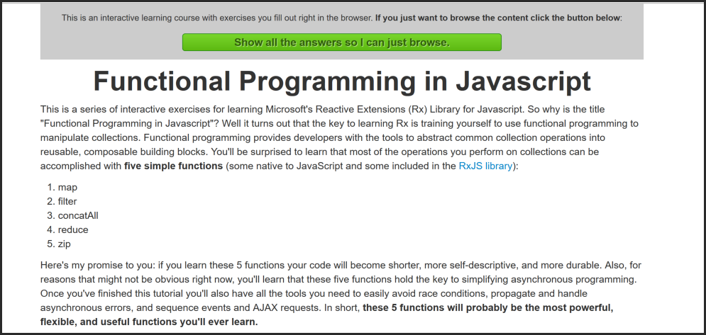

Slide 48
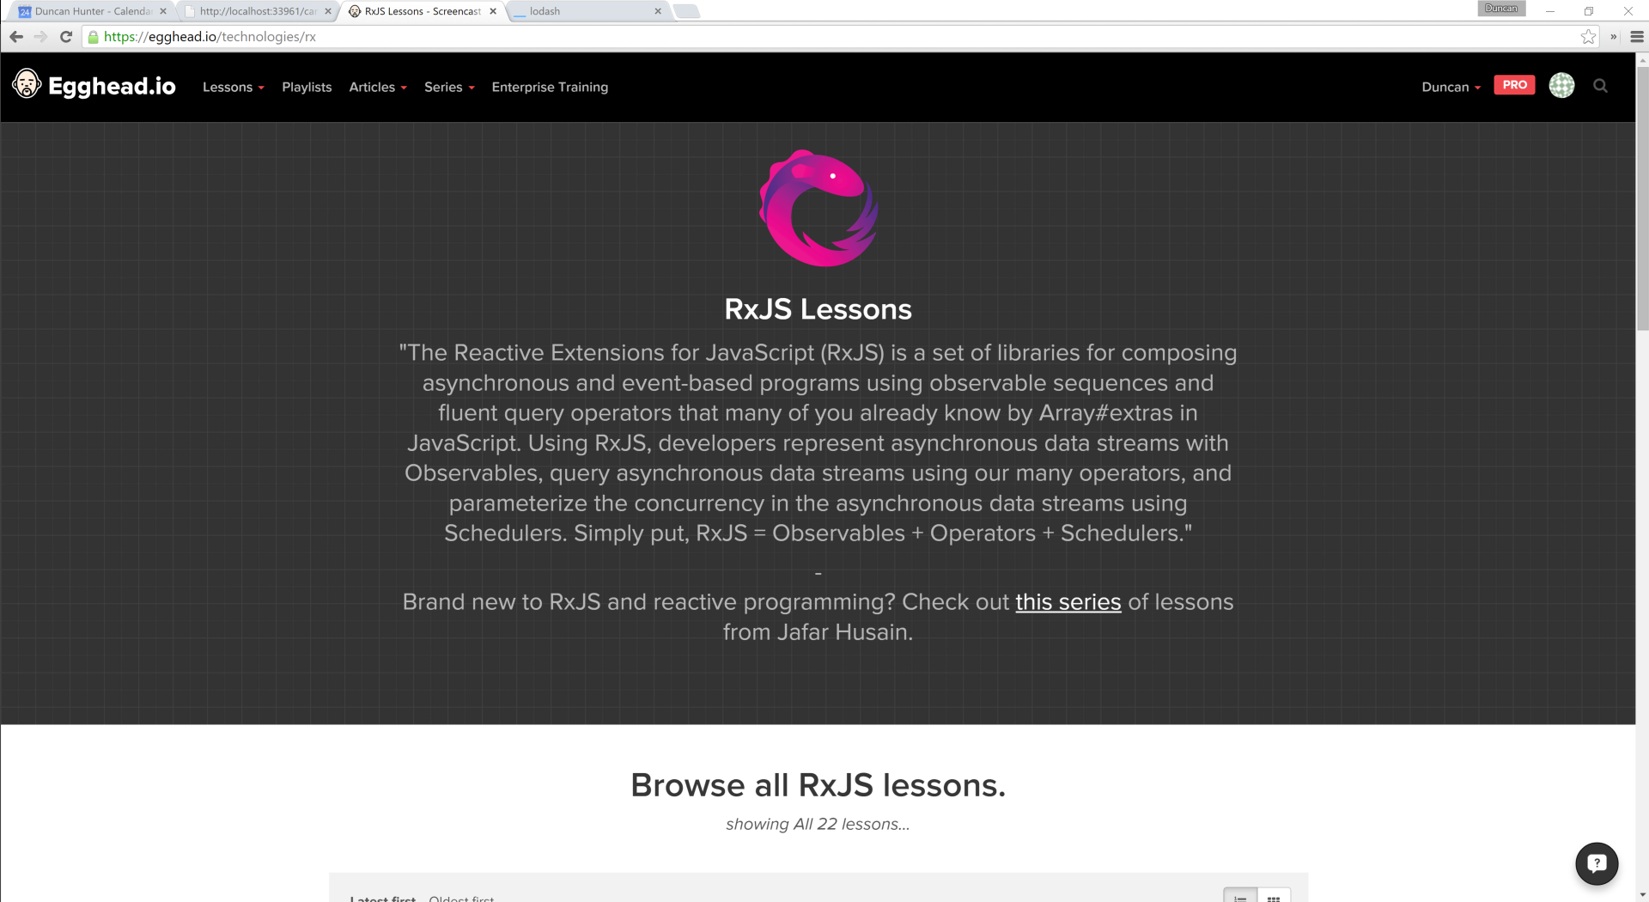

Slide 49
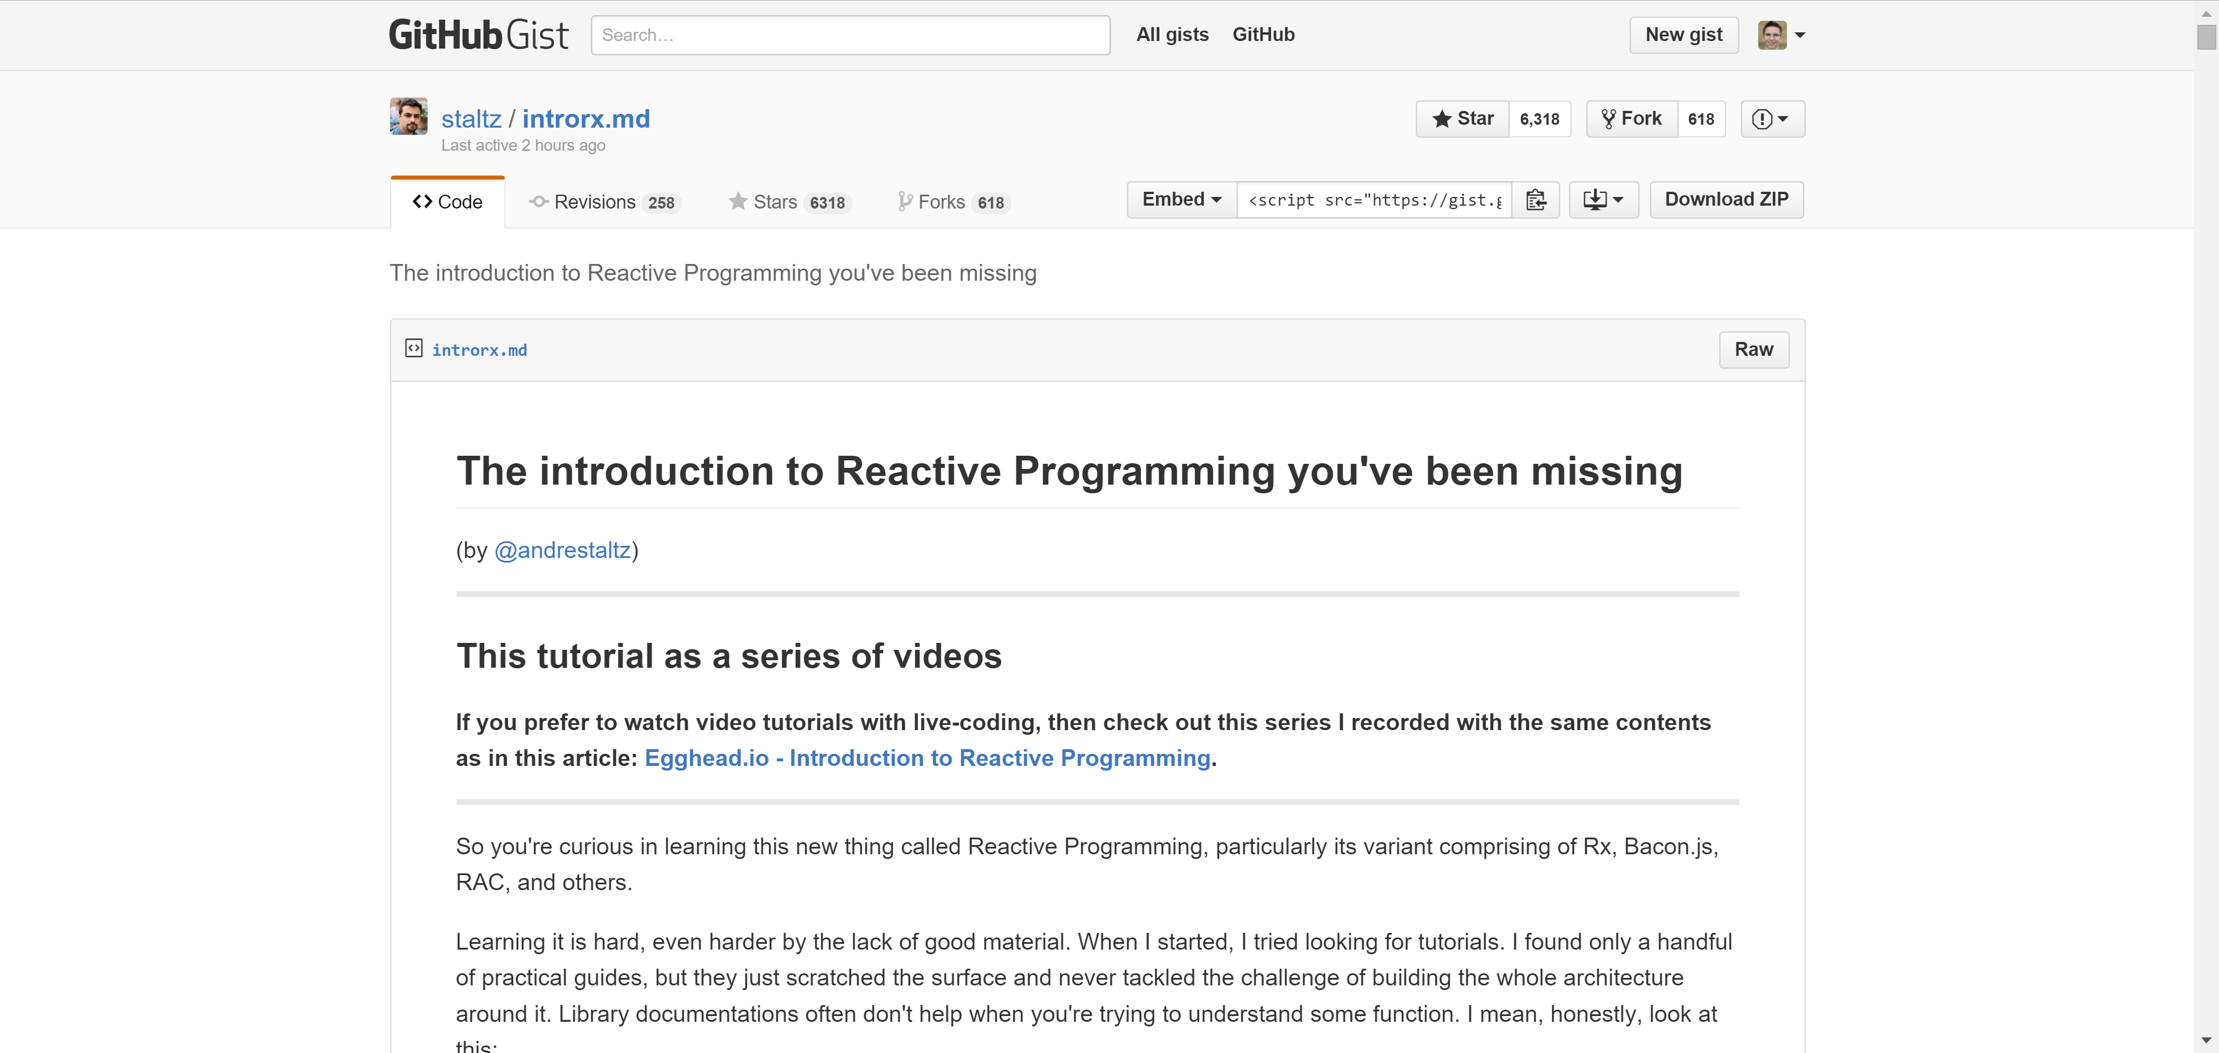

Slide 51
Thank you! duncanhunter@ssw.com.au info@ssw.com.au www.ssw.com.au Sydney | Melbourne | Brisbane | Adelaide

